Slide 1





POST-HCT SURGERY SURVIVAL:
Analysis and Prediction
Group 521
- Behafarin Emam
- Likhita Nallapati
- Shriya Rawal
- Ameen Aghazadeh

Slide 2
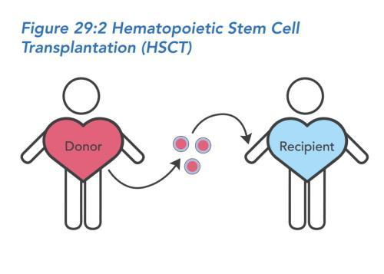


Overview
Inspired by Kaggle Competition on Post-Hematopoietic Cell Transplantation (HCT) survival predictions
Our objective is to identify the factors that most significantly affect survival outcomes post-transplant, which can help tailor treatment plans and improve patient prognosis.
What is Hematopoietic Stem Cell Transplantation ?
HCT is a medical procedure that replaces damaged or diseased blood-forming cells with healthy ones
This procedure is vital for treating hematological diseases such as leukemia, lymphoma, and certain blood disorders.

Slide 3
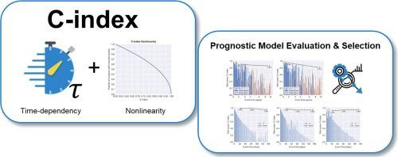
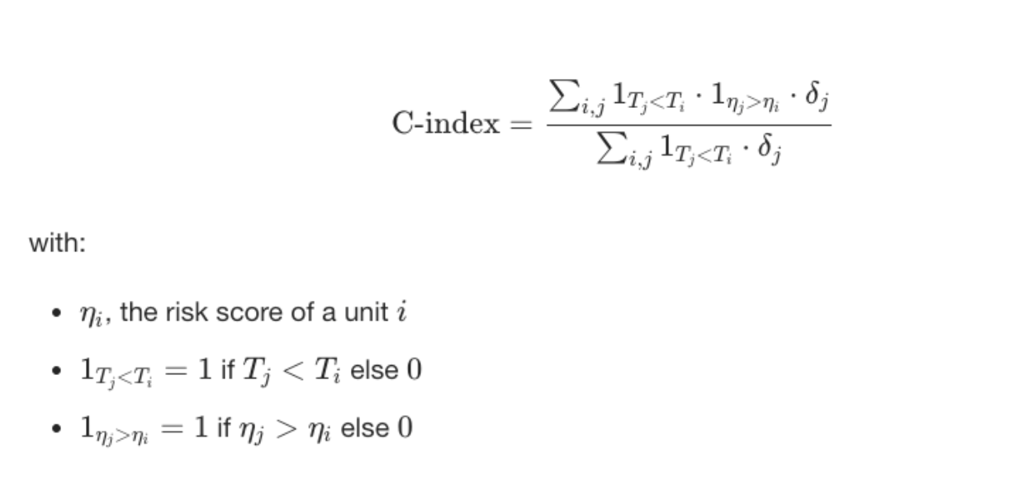
Performance Metric - Concordance Index
C-index assesses the degree of agreement between the predicted risk scores generated by our model and the actual observed outcomes.
CI measures the inverse relationship between risk scores and survival times.
Higher risk scores should correspond to shorter survival times and vice versa.
The concordance index is a value between 0 and 1 where:
0.5
is the expected result from random predictions
1.0
is a perfect concordance : meaning the model can accurately rank all patients by risk.
0.0
is perfect anti-concordance (multiply predictions with -1 to get 1.0)
Notes:
For each pair, if the patient with a higher predicted risk actually experiences the event sooner than the one with a lower predicted risk, it’s considered a concordant pair.
If the opposite happens, it’s a discordant pair.
The C-index is then computed as the ratio of concordant pairs to the total number of comparable pairs
Example: patient has a higher predicted risk score, they should experience an event sooner than a patient with a lower risk score for the model to be considered accurate.

Slide 4


Dataset Analysis
This dataset is suited for both survival prediction and equity-focused analyses.
Demographics
- ethnicity and race group
Treatment details
- HLA match, graft type, and conditioning intensity
28,800 Rows
60 Columns
Medical History
- comorbidity scores, prior tumors, pre-existing conditions: diabetes and cardiac issues
Sex-Match
-Donor and recipient biological sex compatibility and donor age
Outcome variables
- Event-Free Survival & EFS time
representing survival status and time to an event or censoring.
Notes:
Data is a synthetically generated dataset that used the data generator from synthcity, trained on a large cohort of real CIBMTR data.

Slide 5

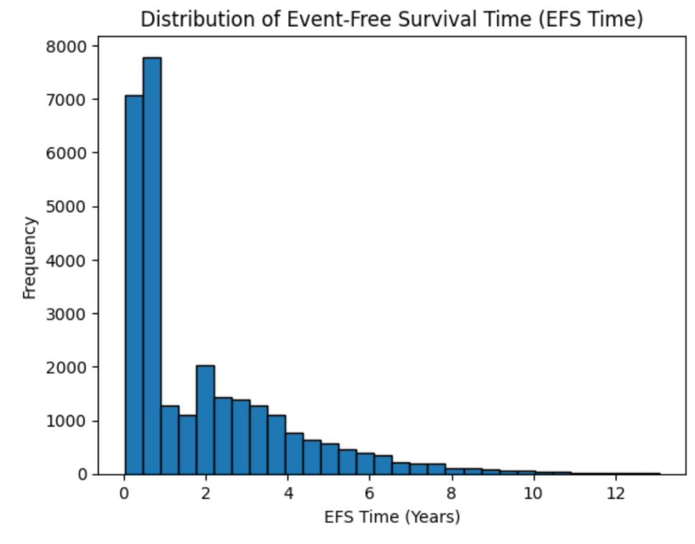
Distribution of Event-Free Survival Time
- The data is right-skewed, with most patients experiencing events within the first two years post-HCT.
- The events here refer to any post-op complication that they may have suffered.
- The skewed nature of the data also posed challenges for our modeling process, particularly for techniques that assume normality (like linear and logistic regression/ pca). To address this, we considered transformations and non-parametric models better suited for skewed data.
Notes:
EFS time represents the duration a patient survives without experiencing major complications or relapse following HCT This skewness highlights a critical window for post-transplant care and monitoring, suggesting that early interventions might be key to improving outcome The steep drop in EFS times for many patients suggests that factors such as comorbidities, donor-recipient compatibility, and treatment protocols might play a significant role during this high-risk period. The skewed nature of the data also posed challenges for our modeling process, particularly for techniques that assume normality(like linear and logistic regression/ pca). To address this, we considered transformations and non-parametric models better suited for skewed data.

Slide 6
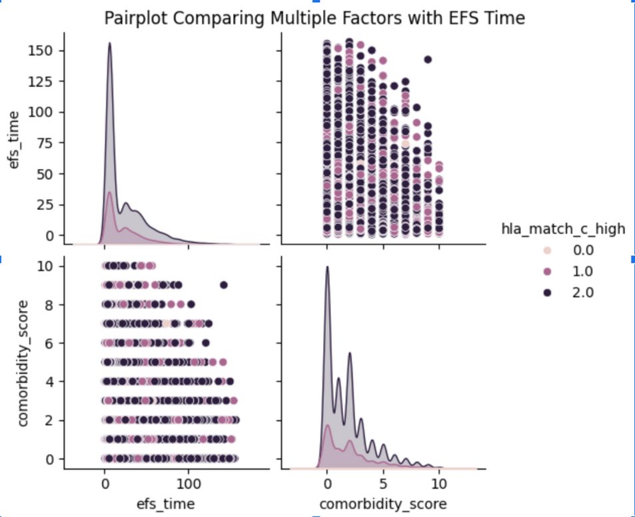
Pairplot
The pairplot examines relationships between EFS time, comorbidity scores, and HLA matching (hla_match_c_high)
Shows patterns in survival times based on these key factors: suggests that higher comorbidity scores may correspond to shorter EFS times.
But not all relationships were simple. Some factors didn’t show a clear pattern, which meant traditional models might not capture these interactions well. Because of this, we tested more advanced machine learning models, like XGBoost and DeepSurv, to improve predictions.
Notes:
"This pairplot helps us look at the relationship between three key factors: Event-Free Survival (EFS) time, comorbidity scores, and HLA matching. The goal is to find patterns that explain why some patients do better after a transplant than others."
One important thing we found is that patients who had more pre-existing health issues tend to have shorter EFS times. This means that those with higher comorbidity scores were more likely to experience complications after the transplant.
"We also see that better HLA matching, which shows how well a donor’s immune system matches the recipient, is linked to longer EFS times. This reinforces the importance of finding the right donor to transplant to reduce the risks."
"But not all relationships were simple. Some factors didn’t show a clear pattern, which meant traditional models might not capture these interactions well. Because of this, we tested more advanced machine learning models, like XGBoost and DeepSurv, to improve predictions."
"Overall, this pairplot helped us pick out the most important features and guided us in choosing the right models to make better survival predictions."

Slide 7
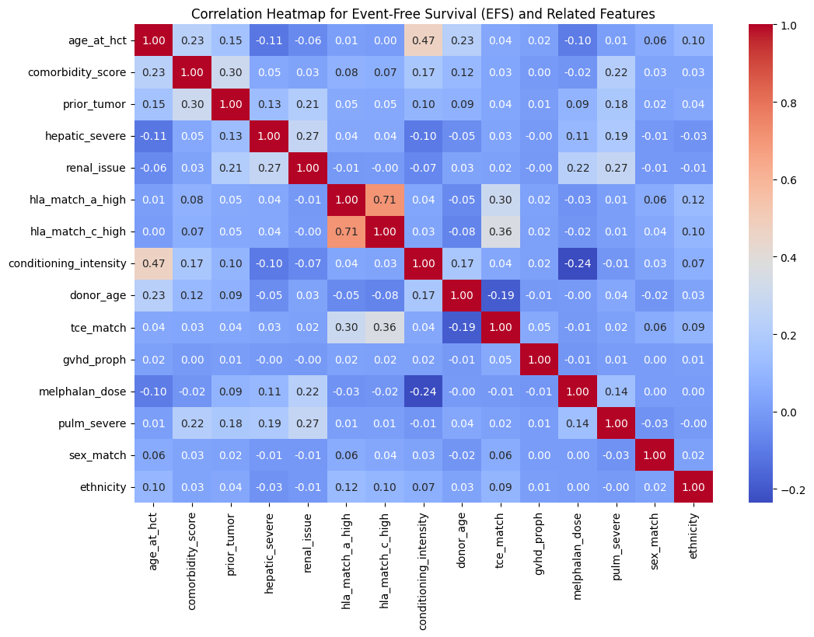
Correlation Heatmap
Key correlations include the relationship between:
- Conditioning Intensity and Age - HLA matching and Survival Outcomes And an unexpected relationship between comorbidity score and graft type, that would need further investigation.
Overall, These provide insights into significant predictors.
Notes:
Next, we have this heatmap, which helps us understand how different factors are related to Event-Free Survival (EFS). The colors represent the strength of these relationships—red means a stronger positive connection, while blue indicates a weaker or negative one."
"One key pattern we noticed is the link between conditioning intensity and age. Conditioning intensity refers to the level of chemotherapy or radiation a patient receives before transplant, and it seems that older patients might be given different treatment plans."
"Another important finding is that better HLA matching is associated with better survival outcomes. Since HLA determines how well the donor’s immune system matches the recipient, this reinforces why finding the right donor is so critical."
"Also, we found an interesting and unexpected relationship between comorbidity scores and graft type. This could suggest that certain types of transplants are used more often for patients with more health issues, which would be worth exploring further."
"Overall, this heatmap was a key part of our analysis, helping us figure out which factors are most important for predicting survival. It also played a big role in guiding our model selection and improving our predictions.

Slide 8
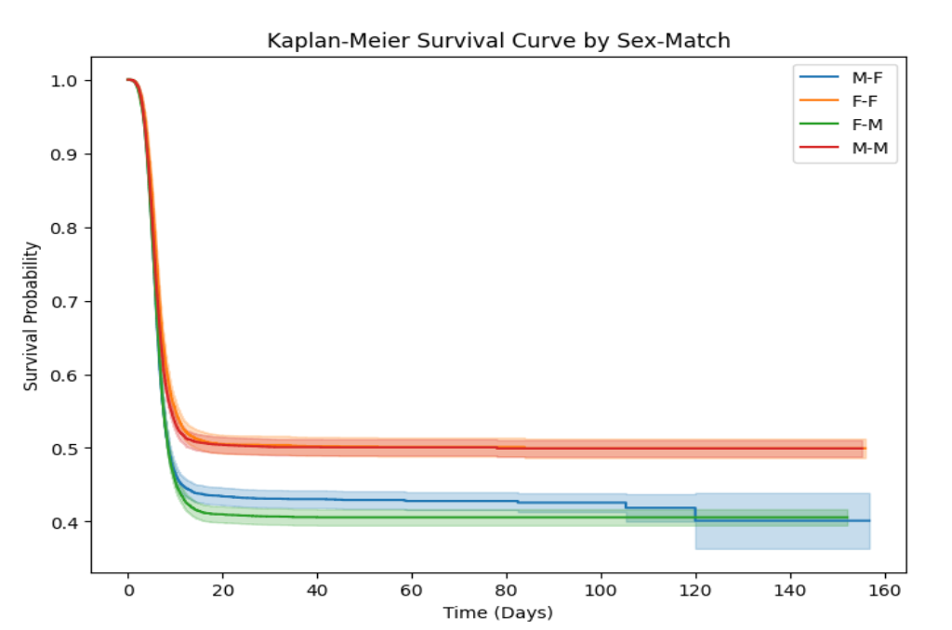
Kaplan-Meier Survival Curve
by Sex-Match
This Kaplan-Meier curve tracks how long patients survive without complications after transplant
Key Observations:
M-M (Male-Male) transplants have the best long-term survival.
F-F (Female-Female) also shows relatively good survival.
M-F & F-M (opposite-sex transplants) drop faster, meaning they experience complications earlier.
Conclusion: Same-sex transplants generally have better survival outcomes over time.
Notes:
Now, looking at this Kaplan-Meier survival curve, we can see how long patients stay free of complications after a transplant, based on whether the donor and recipient are the same sex or different."
"From the graph, we observe that Male-to-Male (M-M) transplants have the best long-term survival, followed by Female-to-Female (F-F). On the other hand, opposite-sex transplants—Male-to-Female (M-F) and Female-to-Male (F-M)—show a steeper drop, meaning these patients experience complications sooner."
"This pattern suggests that same-sex transplants may lead to better survival outcomes over time. Understanding this could help doctors make more informed decisions when selecting the best donor for a patient."
"Overall, this analysis gives us valuable insights into how sex-matching might influence recovery, without requiring deep medical expertise. It highlights an important factor that could be considered in improving transplant success.

Slide 9
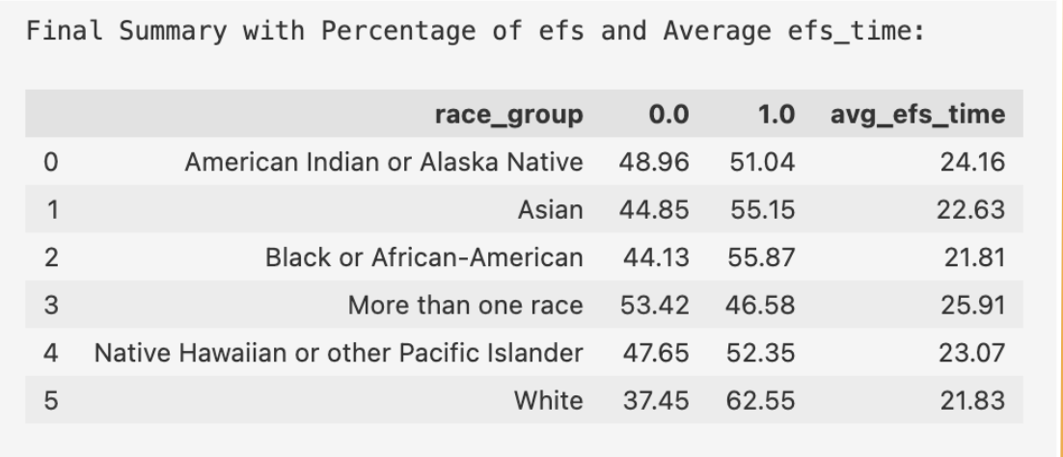
Event-Free Survival by Race Group
Exploitation of Resources
Adaptation Costs
This table shows how Event-Free Survival (EFS) rates and average survival times differ across racial groups. This helps us understand whether some groups tend to have better or worse outcomes after a transplant.
By identifying these patterns here, we can work toward improving transplant success for all patients, making treatments more effective and equitable.
Notes:
Next, we have this table, which shows how Event-Free Survival (EFS) rates and average survival times differ across racial groups. This helps us understand whether some groups tend to have better or worse outcomes after a transplant."
"Looking at the data, we can see that White patients have the highest EFS rate at 62.55%, while patients from multiple racial backgrounds have the lowest at 46.58%. The average time before complications also varies between groups, showing that survival times aren’t the same for everyone."
"This suggests that different factors, such as access to medical care, donor availability, or other health conditions, may influence these outcomes."
"By identifying these patterns, we can work toward improving transplant success for all patients, making treatments more effective and equitable."
"in this table, 0 means the patient experienced a complication or relapse, while 1 means they remained event-free after the transplant.

Slide 10

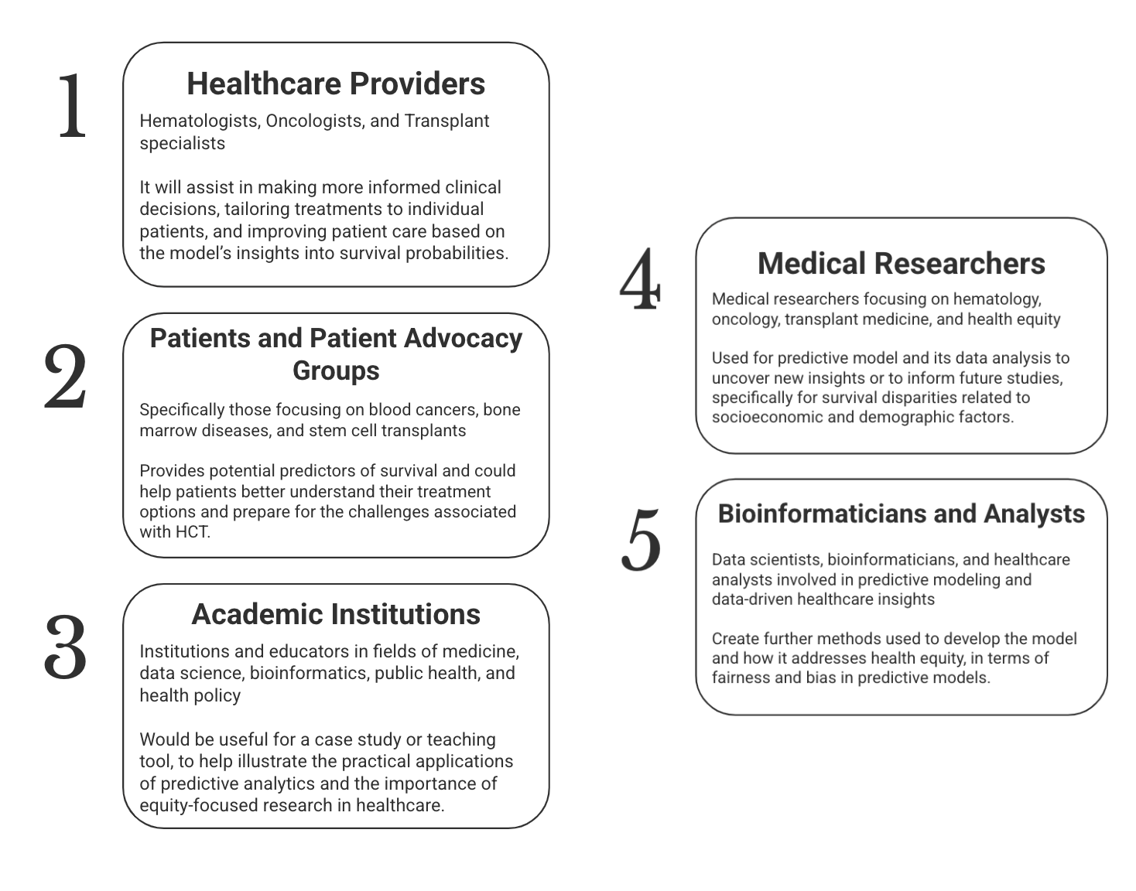

Stakeholders and Applications
Notes:
Who will this analysis be the most helpful for? In order to answer that question we divided our stakeholder int 5 subcategories with the top three categories being Healthcare Providers, Patients & Patient Advocacy Groups and Academic Institutions. Healthcare providers can use this data to make informed clinical decisions.
My aunt is a doctor and I asked her about her opinions on the most important features - to which she replied that it just depends on the patient. One group of variables may be perfect for some and not be useful at all for the others. So we really think that this can help healthcare providers tailor treatments to individual patients and improve their care based on probable survival outcomes. Similarly, this can help patients better understand their treatment options and why they are being treated so.
For academic institutions, this will be great case study because achieving high accuracy is really important but at the same time really hard to achieve with so many interrelated variables.
Lastly, we believe that this analysis can be used by medical researchers and bioinformaticians and analysts to further develop the model with a subject matter expert and analyze how it also addresses health equity in terms of fairness and bias in predictive models.

Slide 11
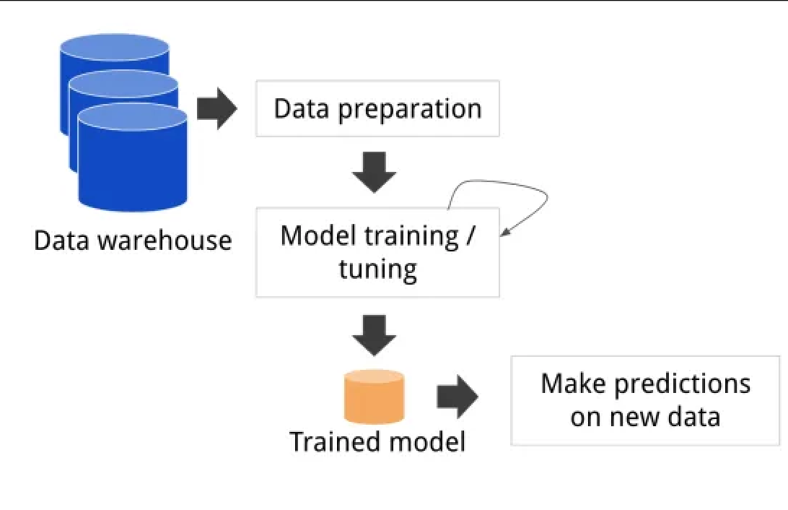

Analytic Approach
Data Preprocessing
Model Creation
Prediction and Analysis
Notes:
For our analytical approach, we started by preprocessing and cleaning our dataset followed by experimenting with model training and tuning.
We spend much of our time on feature engineering to make sure our data is reliable with over 28 thousand rows of data and were able to achieve similar results from three different machine learning models. After which we diverted our focus on getting a higher concordance index to make better predictions.

Slide 12
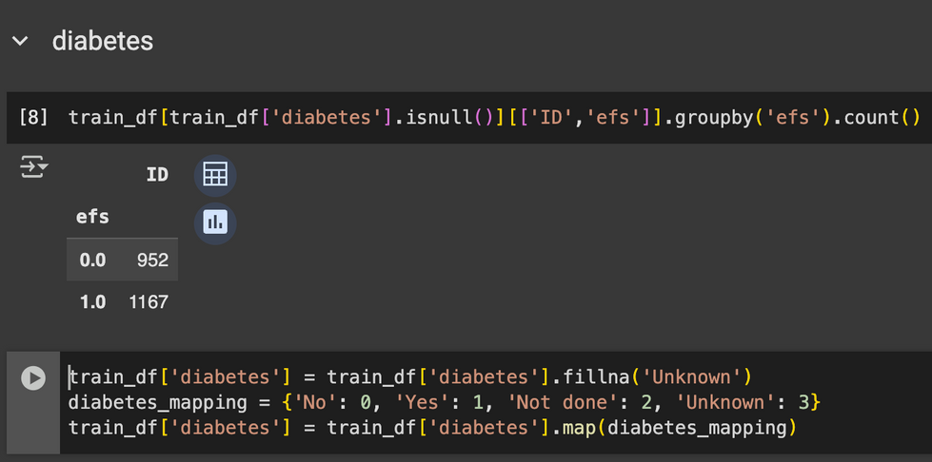
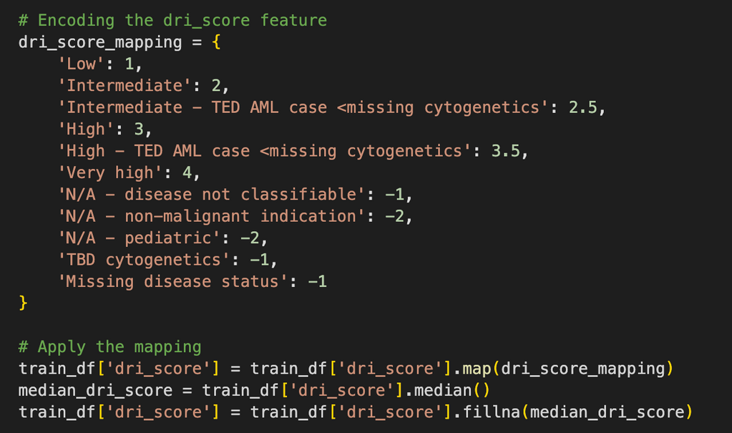
Data Preprocessing and Feature Handling
Total of 60 Features:
35 Categorical Features
25 Numerical Features
Handling categorical & missing values
One-hot encoding & ordinal encoding
Removing highly correlated features
Standardization of numerical features
Nulls were handled and added in a separate unknown category. These null values aren’t evenly distributed across efs and ranked them as -1.
A predefined mapping strategy was used to convert our simpler categorical data into numerical data while handling missing values as -1 as well, and One hot encoding to provide binary (0-1) values for categorical features which had high cardinality (over 5 different values).
After conducting one hot encoding and ordinal encoding the total features were 132 and due to the lack of an SME, we decided to include all features into our models and backtrack them to find the most important features.
Notes:
We initially had a total of 60 features with 35 categorical and 25 numerical fields.
In this example, we handled the nulls in and added them in a separate unknown category. These null values aren’t evenly distributed across efs and ranked them as -1. We did the same across all ordinal values. We used a predefined mapping strategy to convert our simpler categorical data into numerical data while handling missing values as -1 as well. We also used one hot encoding to provide binary (0-1) values for categorical features which had high cardinality (over 5 different values). We standardized our numerical data
After conducting one hot encoding and ordinal encoding our total features were 132 and because we did not have an SME, we decided to include all features into our models and backtrack them to find the most important features.

Slide 13
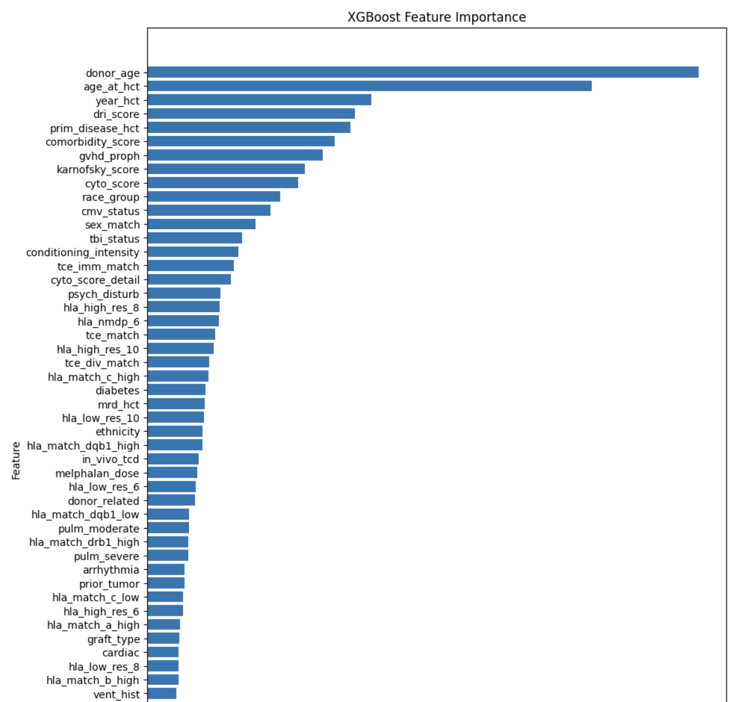
Models :
Kaplan Meier Curve, CoxPH, XGBoost, DeepSurv
Calculated the Kaplan Meier Curve to understand our survival time
Converted predicted survival to risk score
Used different models and received a Concordance index of ~0.67:
CoxPH
L1 = 0.01
Removed columns displaying high collinearity
XGboost
Added AFT bounds for train/test data
Used objective = survival:aft and evaluation metric = aft-nloglik
DeepSurv
Imported top 30 features from xgboost
Used Adam optimizer with learning rate = 0.005
Notes:
The three models we focused on were CoxPH, XGBoost and DeepSurv. All three models are popularly used within the medical fields to predict patient outcomes.
We were able to achieve a concordance index of 67% which means that our model was 67% accurating in predicting patient survival time post cell transplant procedures and also provided the top 30 features.
We started with the simplest modelling technique which is the CoxPH model and finetuning it with a L1 value set to 0.01, this resulted in 66% accuracy, so we went one step ahead and tried a more robust XGBoost model which is known to handle datasets where feature importance is not known earlier. This gave us a 67% accuracy as well as top features with their importance as a %.
I do want to mention that the competition is now closed and I believe the winner was able to achieve 70% accuracy so we believe that there is a lot of room for improvement but being able to achieve 67% was a good start. We finally tried the DeepSurv model to utilize some deep learning insights to see if we can further improve our accuracy score.

Slide 14
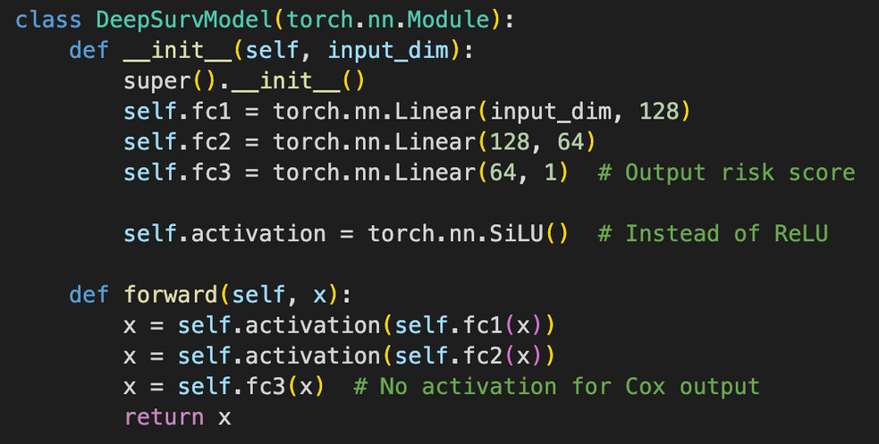
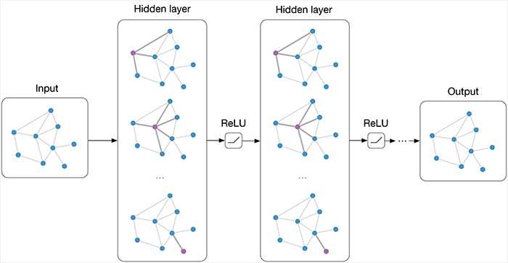
Deep Models
DeepSurv
Adjustments (from 63% to 66%)
Relu and Silu work better than leakyrelu
A very low learning rate doesn't work
Simpler network is better
Bigger the number of epochs the better
First 30 features from xgboost
K-fold helps stabilize the cv
GNN
58%
Used Cosine similarity to build the edges (find close nodes), the winner used KNN

Slide 15
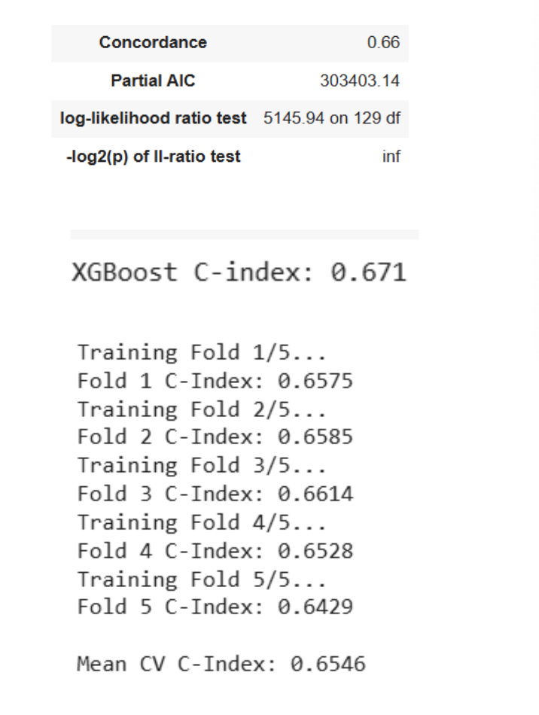
Prediction and Analysis
Predicted Risk Scores:
Patients with higher predicted risk scores showed a tendency towards worse survival outcomes.
Median Survival Time:
9.98 months, highlighting a critical threshold for patient survival following HCT.
Model Sensitivity:
We were able to achieve ~66% accuracy with DeepSurv, ~66% accuracy with CoxPH and ~67% accuracy with XGBoost models
While the C-index of 0.67 suggests moderate accuracy, there is room for improvement. Future iterations could explore model tuning or the inclusion of additional data to refine predictions.

Slide 16

Challenges and Limitations
Data imbalance : Highly skewed
With most patients experiencing events within the first two years, making long-term survival predictions challenging
Need for external validation
The models are trained on a specific dataset and may not generalize well to different patient populations without further validation on external datasets.
Moderate Predictive Performance
With the average prediction score being ~0.66 between our models, leaves room for improvement
Domain Knowledge Limitations
Challenging to determine the most critical features for survival prediction and interpret complex medical variables effectively

Slide 17


THANK YOU!
Q & A time

Slide 18
Team members and Contributions
All team members contributed to the exploratory data analysis (EDA) by analyzing key features, identifying trends, and visualizing data patterns to inform our modeling approach. Additionally, for the data preprocessing, everyone handled and encoded ¼ of the features to be used in the model.
Behafarin Emam
Responsible for preprocessing and engineering features, including data cleaning, normalization, encoding, and selection to enhance model performance
Implemented DeepSurv and GNN predictive models to predict accurate risk score
Likhita Nallapati
Developed an ensemble model combining XGBoost and CatBoost to improve the accuracy of survival predictions. I also integrated the strengths of both models to handle non-linear relationships for survival analysis.
Shriya Rawal
Conducted survival analysis using CoxPH model and finetuned with LASSO regression to achieve higher accuracy for survival prediction. I also utilized the Kaplan-Meier Curve to understand distribution of values as well as the median survival time.
Ameen Aghazadeh
Analyzed the impact of sex-matching on survival outcomes using Kaplan-Meier survival curves and bar charts to determine whether same-sex transplants had better long-term survival. Investigated race-based differences in Event-Free Survival (EFS) to identify potential disparities in post-transplant outcomes. Contributed to feature analysis using correlation heatmaps, helping refine important survival predictors and guide model selection.

